Slide 1
Asset Allocation and Recommendation System
Qianrui Zhang(qz2354), Tianyi Lin(tl2957)

Slide 2
Background

Slide 3
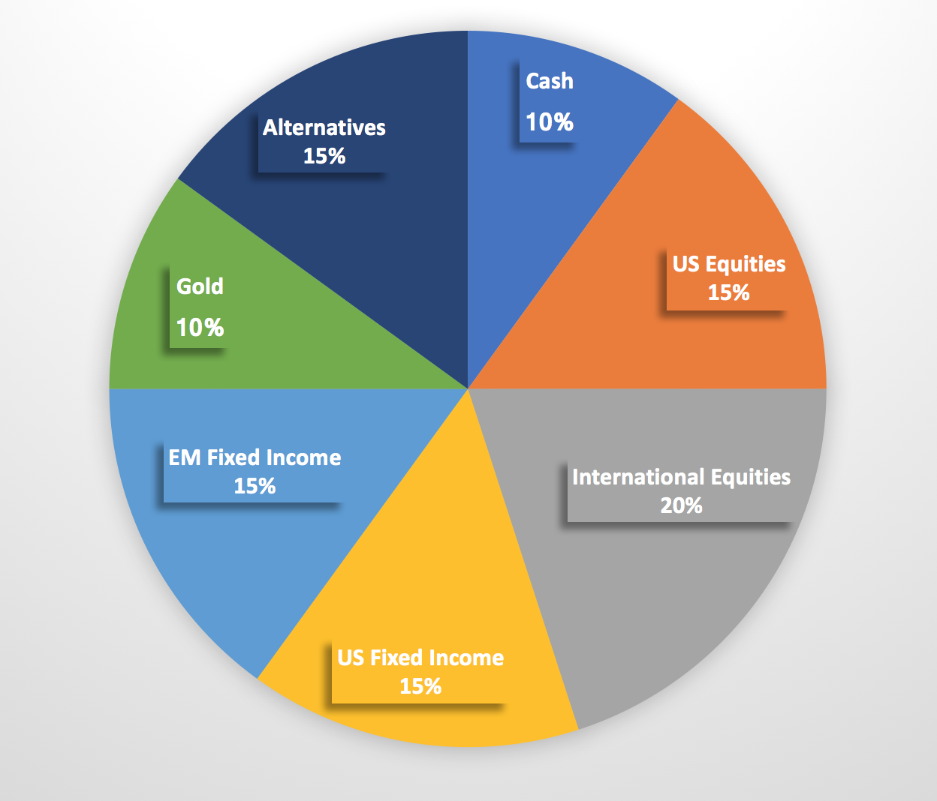

Background
Asset Allocation
Traditional Assets
Cryptocurrencies
Notes:
asset allocation is the practice of dividing resources among different categories such as stocks, bonds, mutual funds, etc.

Slide 4
2. Past Related Work

Slide 5
Past Asset Allocation Strategies
existing deep machine-learning approaches → mostly try to predict price movements or trends (Heaton et al., 2016; Freitas et al., 2009).
Pros:
straightforward to implement because it is supervised learning
Cons:
performance highly depends on the degree of prediction accuracy
future market prices are difficult to predict
Notes:
There are existing deep machine-learning approaches to financial market trading. However, many of them try to predict price movements or trends
With history prices of all assets as its input, a neural network can output a predicted vector of asset prices for the next period. Then the trading agent can act upon this prediction. This idea is straightforward to implement, because it is a supervised learning, or more specifically a regression problem. The performance of these price-prediction-based algorithms, however, highly depends on the degree of prediction accuracy, but it turns out that future market prices are difficult to predict. Furthermore, price predictions are not market actions, converting them into actions requires additional layer of logic.

Slide 6
Reinforcement Learning models
single-asset trading models: Moody and Saffel [2] and Deng et al. [3]
deep RL framework + Ensemble of Identical Independent Evaluators (EIIE) topology+ CNN/RNN/LSTM: Jiang et al. [1]
deep Q-learning + MQ-Trader framework+multiagent: Lee. et al.[9]
Reinforcement learning recurrent neural network training, PPO, etc.
Notes:
With RL: we can teach an agent to take the actions to maximize reward. RL interact with the environment and learn the policy of changing the asset weights dynamically in a continuously changing market.
that will take history of an asset and evaluate its potential to grow in near future. Its unique way to calculate the score of each asset is then given to a softmax layer to output the new portfolio weights for the next time period.[1] The weights give guidance to the RL agent in making market decisions. The paper also runs tests on different types of IIEs: Convolutional Neural Network (CNN), a basic Recurrent Neural Network (RNN), and Long Short Term Memory (LSTM).
The proposed approach incorporates multiple Q-learning agents, allowing them to effectively divide and conquer the stock trading problem by defining necessary roles for cooperatively carrying out stock pricing and selection decisions.

Slide 7
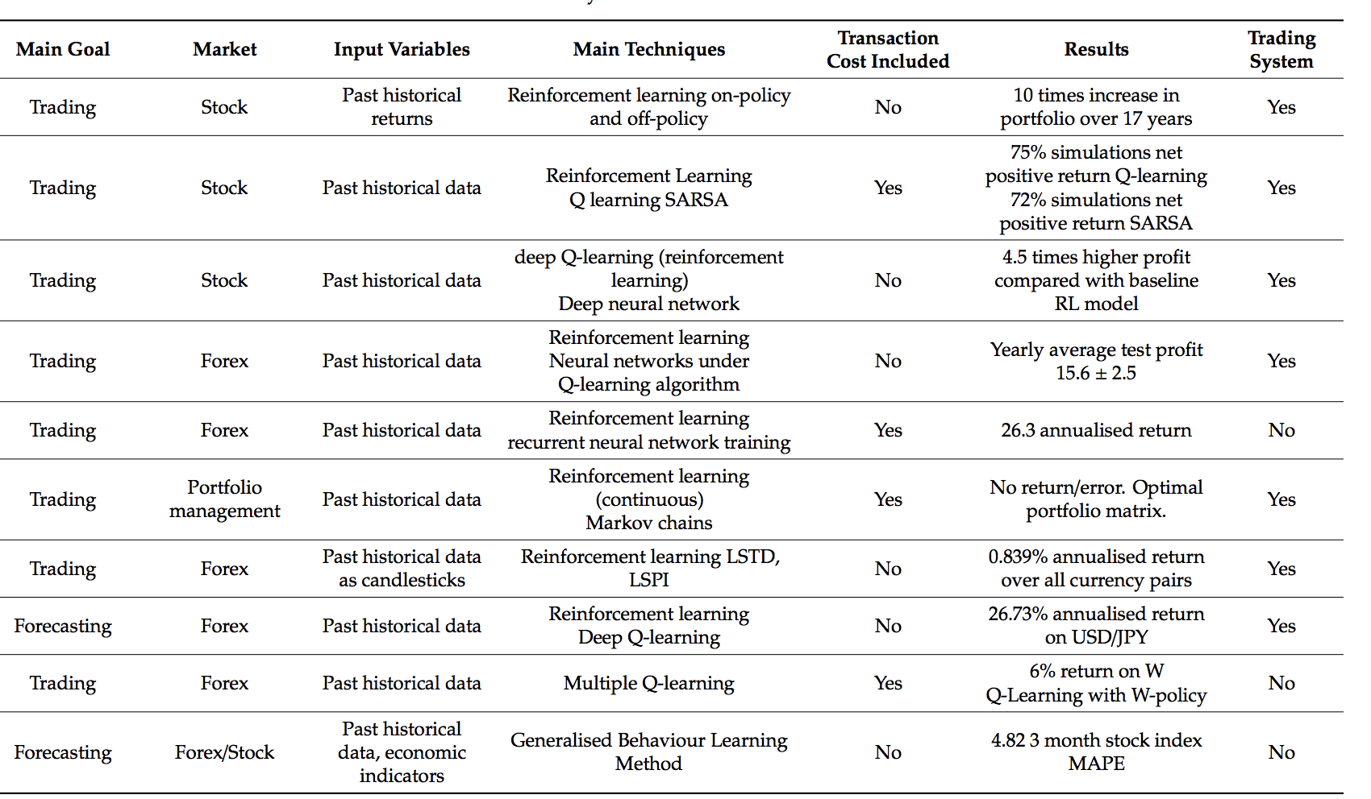
Notes:
Meng T L, Khushi M. Reinforcement Learning in Financial Markets[J]. Data, 2019, 4(3): 110.

Slide 8
3. Our recommendation
system

Slide 9
Idea & Novelty
recent related work:
train their models on 1 type of asset
propose a model that works best for that asset type
adding cryptocurrency to the asset allocation will increase the portfolio’s effectiveness [7]
minimize the standard deviation
more allocation options
optimum allocation of Cryptocurrency is from 5% to 20% depending on the risk tolerance of the investor

Slide 10
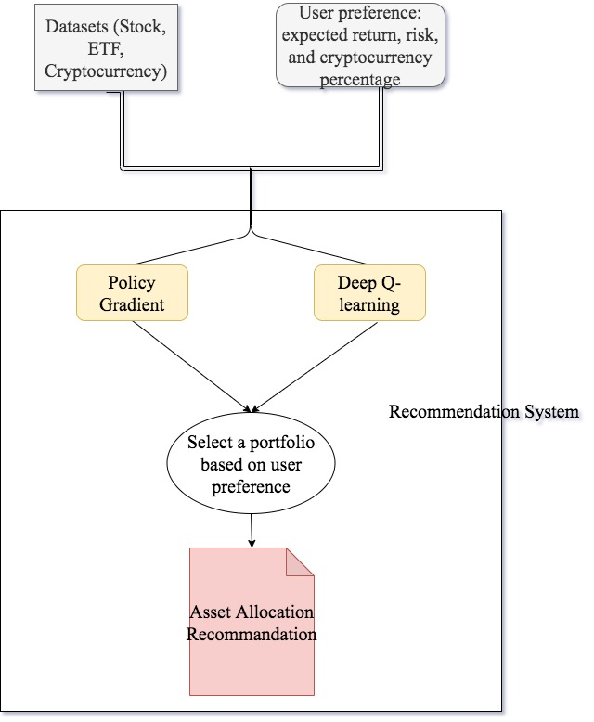
Our Recommendation System
Input:
combined datasets of s & p 500 stock, ETF (exchange-traded fund) and cryptocurrency dataset.
users choice on the level of preference on expected return, risk, and a range for the amount of accepted cryptocurrency purchased
Output:
generates a report which optimally allocate funds of a finite budget on the available assets
includes the names and amount of assets that the user should invest in
Notes:
Our project targets to implement an asset allocation recommendation system that gives user a portfolio including both traditional asset and cryptocurrency

Slide 11
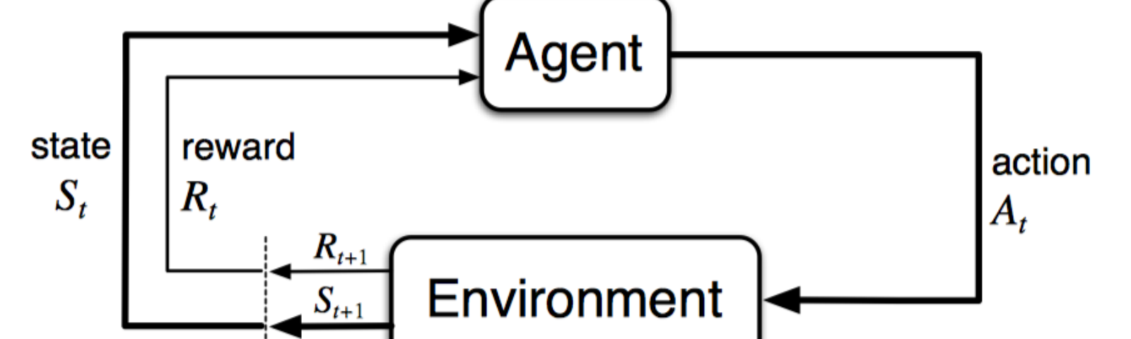
RL methods we choose:
model-free RL models, take in transaction cost, works on multiple assets
From Cryptocurrency:
deep RL with EIIE topology, Policy Gradient (PG) strategy and CNN in [1]
From Stock:
deep Q-learning + multiagent [10]
Notes:
model-free RL is good for chaotic environment dynamics and tractable true objective, our system will choose model-free RL models.
From Cryptocurrency: choose the deep RL with EIIE topology, Policy Gradient (PG) strategy and CNN in [1] because it achieves better portfolio value and efficiency over benchmarks on cryptocurrency datasets
Stock:deep Q-learning method in [10], as it shows 4.5 times higher profit compared with baseline RL model. The proposed framework, which is named MQ-Trader, takes a multiagent approach in which each agent has its own specialized capability and knowledge, and employs a Q-learning algorithm to train the agents

Slide 12
Technical Challenge
Incorporate user preference into the portfolio deciding process
Training and tuning of the RL models
Construct testing for our recommendation system
Notes:
since both team members are not familiar with reinforcement learning, so this part will involve lots of studying and experimentation
back-test: where the trading agent pretends to be back in time at a point in the market history, not knowing any ”future” market information, and does paper trading from then onward.

Slide 13
4. Data

Slide 14



Our Datasets
Yahoo! Finance API and ETF DB
S and P 500
ETF (exchange-traded fund) Data
Cryptocurrency Historical Data
Notes:
Data collecting difficulty.

Slide 15

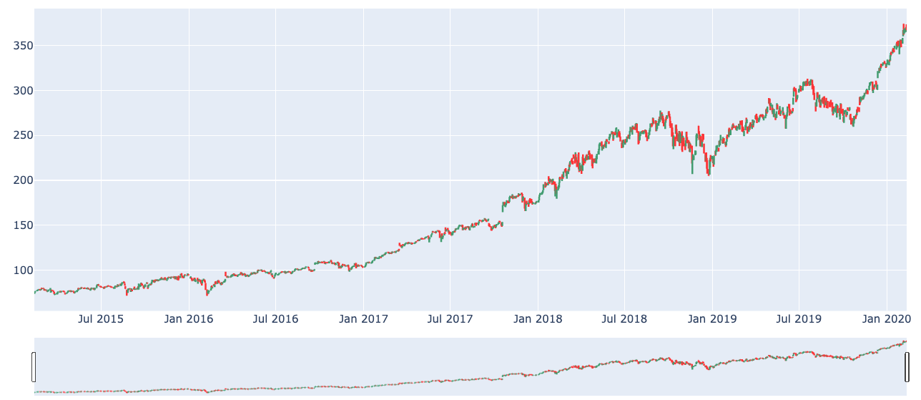
Our datasets
Open-Close-High-Low Value
Five years
Stream data

Slide 16
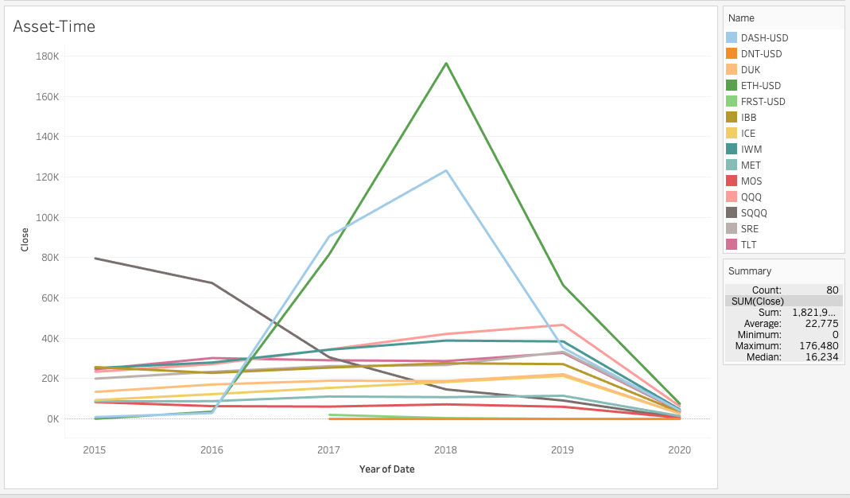
Our Datasets
500 stocks
1500 ETFs
100 Cryptocurrencies

Slide 17
Data Collection Difficulty
Yahoo! Finance API expires (use yfinance instead)
Get ETF and cryptocurrency list
Choose what data to use

Slide 18
5. Milestone Planning

Slide 19
Milestone Planning
Milestone 1: proposal, data collection and data preprocessing
Milestone 2: model selecting and training
Milestone 3: model evaluation, optimization
Final: build a recommendation system based on model

Slide 20
Thank you!

Slide 21
Reference
[1] Jiang Z, Xu D, Liang J. A deep reinforcement learning framework for the financial portfolio management problem[J]. arXiv preprint arXiv:1706.10059, 2017.
[2] Moody J, Saffell M. Learning to trade via direct reinforcement[J]. IEEE transactions on neural Networks, 2001, 12(4): 875-889.
[3] Deng Y, Kong Y, Bao F, et al. Sparse coding-inspired optimal trading system for HFT industry[J]. IEEE Transactions on Industrial Informatics, 2015, 11(2): 467-475.
[4]Li X, Li Y, Zhan Y, et al. Optimistic bull or pessimistic bear: adaptive deep reinforcement learning for stock portfolio allocation[J]. arXiv preprint arXiv:1907.01503, 2019.
[5]Wu C Y, Pandey V K, Dba C. The value of Bitcoin in enhancing the efficiency of an investor’s portfolio[J]. Journal of financial planning, 2014, 27(9): 44-52.
[6]Baur D G, Hong K H J, Lee A D. Bitcoin–Currency or Asset?[J]. Melbourne Business School, 2016.
[7]Andrianto Y, Diputra Y. The effect of cryptocurrency on investment portfolio effectiveness[J]. Journal of finance and accounting, 2017, 5(6): 229-238.
[8]Li B, Hoi S C H. Online portfolio selection: A survey[J]. ACM Computing Surveys (CSUR), 2014, 46(3): 1-36.
[9] Lee, J.W.; Park, J.; O, J.;Lee, J.; Hong, E. A Multiagent Approach to Q-Learning for Daily Stock Trading. IEEE Trans. Syst. ManCybern. -Part A Syst. Hum. 2007, 37, 864–877.

Slide 22
Q & A

